Slide 1


Division of Drinking Water Review of Aquifer Storage and Recovery (ASR) Projects
February 21, 2018
Ying-Ying Macauley

Slide 2
Topics
Division of Drinking Water (DDW) Overview
ASR Review — Water Quality
ASR Review — Project Design
ASR Review — Water System Preparation
DDW Review Process

Slide 3
Division of Drinking Water — Mission
Work cooperatively with drinking water professionals and the public to ensure a safe and reliable supply of drinking water
DDW regulates more than 1,000 public water systems (PWS) in Utah.

Slide 4
Public Water System (PWS) Thresholds
Serve 15 connections or more
Under the same ownership or control
OR an average of at least 25 people daily for at least 60 days out of the year
Population Served — 25 people (8 service connections)
Operating Period — 60 days a year

Slide 5
DDW Plan Review Program
Ensure conformance with UAC R309
Standard engineering practices
Review and approve the plans and specs

Slide 6
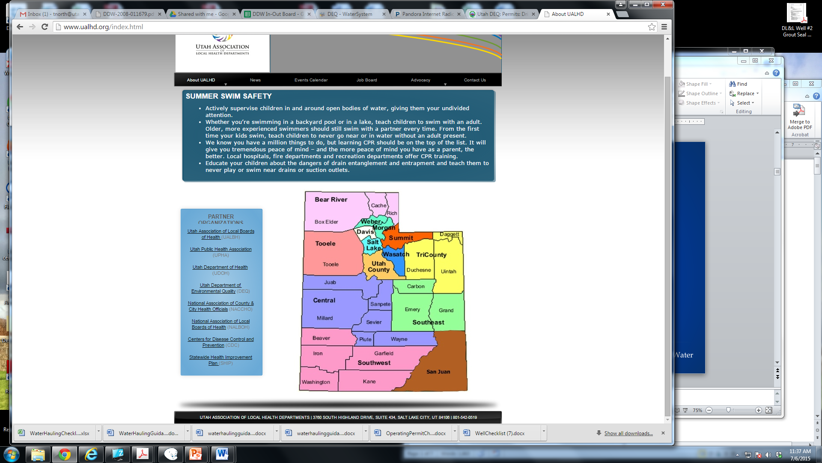
DDW Engineering
Review Program
DDW Engineers
4 DEQ District Engineers
    Central Utah
    Southwest Utah
    Southeast Utah
    Tri-county

Slide 7
Review ASR Projects — Water Quality
Ground Water
Past results of coliform and/or E. coli
Onsite Inspection
Treated Surface Water
Surface water treatment requirements
Disinfectant residual (detectable – 0.5 ppm)
Recent Sample Results
Source sampling (bact., DO, MPA, etc.)
Taken prior to disinfection & during warm months
Notes:
Protect public health by prevent overfeeding & protect operator safety by proper design

Slide 8
Review ASR Projects — Design
Pilot vs. Full Scale
Methods of Delivering Source Water & Injection
One Well vs. Two Wells
Hydraulic Evaluation

Slide 9
Review ASR Projects — PWS Preparation
Gather WQ Data
Source (bact., DO, MPA)
Distribution System (bact., DBP)
Gather Operation Data
Flow history
Hydraulic Limitations
Talk to the Right People
Consultant
Cross Connections
Water Quality
Drinking Water
Water Rights
Water Resources
UT Geological Survey
…..

Slide 10
DDW Plan Review Process
PWS submit Project Notification Form & req’d info
Issue Operating Permit
Water system places new facilities into service
Conduct construction inspection
Issue Plan Approval to allow construction
Review engineering plans, specs and data

Slide 11
ASR Submittal to DDW
ASR Checklist
Source Description & WQ Data
Source Water Delivery & Injection Methods
Injection Period & Quantity
Plans & Specifications
Assessment of Water System

Slide 12

Ying-Ying Macauley
Assistant Director
Division of Drinking Water
(801)536-4188
ymacauley@utah.gov

